Slide 1
Computational Genomics WS
Tajima’s D
Changes in the Allele Frequency Spectrum,
Differences in the Estimators of 𝛳,
Sliding Windows

Slide 2
Topics for Today
Review of Coalescent Processes and Neutral Expectations
R code solutions for last week
Population Mutation Rate (𝜃)
Waterson’s estimator
Nucleotide Diversity (𝛱)
Effects of Selection on Allele Frequencies Spectra
Measuring these with Tajima’s D
Sliding Window Tests

Slide 3
Coalescent Trees: Review
A way to model a possible history of all of the chromosomes/pieces of DNA in a population
Work backwards in time until you get to the most recent common ancestor (MRCA)
Coalescent events happen randomly at each step.

Slide 4
Coalescent Trees: Review
As you keep going farther back (and reducing the number of samples), you have to wait longer and longer for a coalescent event to happen
The waiting time for coalescence is geometrically distributed with respect to sample/population size; the total waiting time to the MRCA is roughly 4N

Slide 5
Coalescent Trees: Review
If each “branch” has an equal probability of experiencing a mutation, then you will see the most mutations in the time step where you have the most branches

Slide 6
Coalescent Trees: Review
Since most branches lead to only 1 or 2 individuals, we can expect under neutrality that most mutations are rare, or have a low frequency in the population.

Slide 7
Allele Frequency Spectrum
X-axis: Either the allele frequency or sometimes the raw count
Y-axis: The number of SNPs in the population with that frequency or count
What about the shape of the spectrum from last week’s exercise?

Slide 8
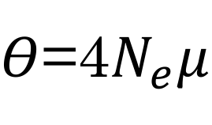
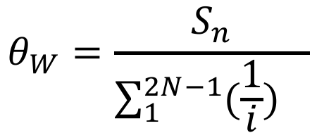
Population Mutation Rate (𝜽)
Probability a mutation has happened at any base in a gene in any individual in a population.
$Θ$=4$N_{e}μ$
Waterson’s Theta (𝛳_{W}):
$$θ_{W}=\frac{S_{n}}{{\sum_{1}^{2N−1}{(\frac{1}{i})}}_{}}$$
S_{n} is the total number of segregating sites (SNPs)
2N is the number of chromosomes (2 times the number of diploid individuals in a sample)
Notes:
The population mutation rate (much like the population recombination rate), is a function of mu, but is extended to be the probability of a mutation at any base pair in any individual in a population (that could have happened at any time)
Waterson’t theta uses the number of segregating sites, scaled by 1/#chromosomes the site could be on
Pi/nucleotide diversity is the mean number of differences between a pair of sequences in the population

Slide 9
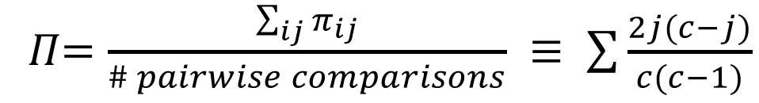
Population Mutation Rate (𝜽)
Probability a mutation has happened at any base in a gene in any individual in a population.
$Θ$=4$N_{e}μ$
Nucleotide Diversity (𝛱):
𝛱$=\frac{\sum_{ij}{π_{ij}}}{\# pairwise comparisons} ≡ \sum{\frac{2j(c−j)}{c(c−1)}}$
j = the number of derived alleles
c = the total number of chromosomes/alleles
∑ = summed over ALL SNP sites in a sequence
This is the Average Number of Differences between any 2 sequences in the Sample/Population.
Notes:
The population mutation rate (much like the population recombination rate), is a function of mu, but is extended to be the probability of a mutation at any base pair in any individual in a population (that could have happened at any time)
Waterson’t theta uses the number of segregating sites, scaled by 1/#chromosomes the site could be on
Pi/nucleotide diversity is the mean number of differences between a pair of sequences in the population

Slide 10
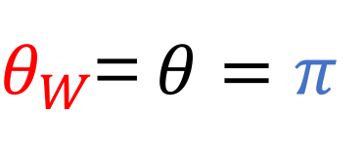
Under Neutrality:
Estimators of 𝛳
$θ_{W}$=$θ=π$
BUT, if allele frequencies are being driven by non-neutral forces, then the two estimators will be DIFFERENT.
We can use this difference to test for selection (i.e. test for skew in the frequency spectrum).
Notes:
Why calculate both estimators?
Because, if the mutations fall on the coalescent tree in a way that is consistent with neutrality, then both estimators estimate the “true” theta and are equal to each other
BUT, if something happens (i.e. the probability of a mutation happening in any one individual is NOT the same as the probability of us observing it), the estimators will be different, and thus can actually measure the skew in the AFS
The difference in the estimators is the Tajima’s D statistic, which we will cover next week

Slide 11
Left-Skewed Frequencies
Neutral
Skewed
Minor Allele Freq.
Spectrum (Folded)
Max x value = 0.5
Derived Allele Freq. Spectrum (Unfolded)
Max x value = 1

Slide 12
Left-Skewed Frequencies
Neutral
Skewed
An Excess of Rare Alleles can be caused by:
Purifying Selection (selection against new mutations)
Strong Positive/Directional Selection (selection for certain mutations)
Selective Sweep (everything is driven towards fixation)
Exponential population growth; rapid expansion

Slide 13
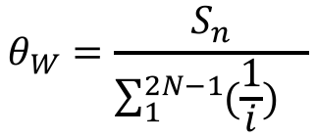
Left-Skewed Frequencies
Neutral
Skewed
An Excess of Rare Alleles can make 𝛳_{W} look too high:
$$θ_{W}=\frac{S_{n}}{{\sum_{1}^{2N−1}{(\frac{1}{i})}}_{}}$$
𝛳_{W} is driven by the NUMBER of SNPs, regardless of their frequency, so it will still be high even if almost all mutations are rare within the population

Slide 14
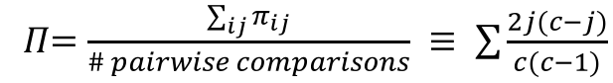
Left-Skewed Frequencies
Neutral
Skewed
An Excess of Rare Alleles shouldn’t effect 𝛱 much:
𝛱$=\frac{\sum_{ij}{π_{ij}}}{\# pairwise comparisons} ≡ \sum{\frac{2j(c−j)}{c(c−1)}}$
But 𝜋 is the AVERAGE number of differences. If mutations are rare (i.e. each only occurs in 1 individual), then the number of differences is LOW

Slide 15
Right-Skewed Frequencies
Neutral
Skewed
Minor Allele Frequency
Derived Allele Frequency
An Excess of Intermediate Freq. Alleles can be caused by:
Balancing Selection (selection for multiple alleles in a population)
E.g. Frequency-Dependent Selection
Plasticity
Heterozygote Advantage
Population Bottleneck (population shrinkage)

Slide 16
Right-Skewed Frequencies
Neutral
Skewed
Minor Allele Frequency
Derived Allele Frequency
An Excess of Intermediate Freq. Alleles shouldn’t have much effect on 𝛳_{W}:
$$θ_{W}=\frac{S_{n}}{{\sum_{1}^{2N−1}{(\frac{1}{i})}}_{}}$$
𝛳_{W} is driven by the NUMBER of SNPs, regardless of their frequency, so it will not be any higher even if each SNP has a high freq.

Slide 17

Right-Skewed Frequencies
Neutral
Skewed
Minor Allele Frequency
Derived Allele Frequency
An Excess of Intermediate Freq. Alleles will make 𝛱 appear too high:
$$π=\frac{\sum_{ij}{π_{ij}}}{\# pairwise comparisons}$$
But 𝜋 is the AVERAGE number of differences. If mutations are have a higher frequency in the population, this will increase the probability of observing a difference between a pair of sequences.

Slide 18
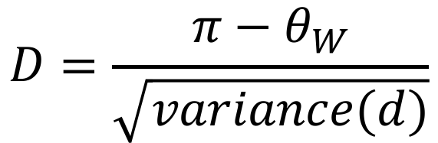
Tajima’s D
$$D=\frac{{π−θ}_{W}}{\sqrt{variance(d)}}$$
Normalized test of the difference between the estimators of 𝛳
D < 0: excess rare alleles
D > 0: excess intermediate frequency alleles
D = 0: data fit the neutral mutation model
Tajima (1989)

Slide 19
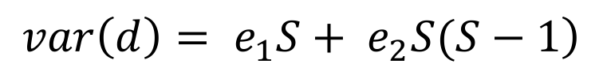
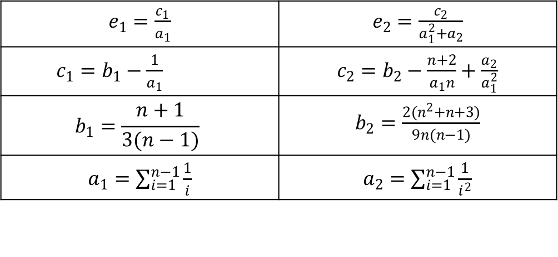
Tajima’s D
$$D=\frac{{π−θ}_{W}}{\sqrt{variance(d)}}$$
$$\left.var\left(d\right)= e_{1}S+ e_{2}S(S−1\right)$$
$e_{1}=\frac{c_{1}}{a_{1}}$ | $e_{2}=\frac{c_{2}}{a_{1}^{2}+a_{2}}$
$c_{1}=b_{1}−\frac{1}{a_{1}}$ | $c_{2}=b_{2}−\frac{n+2}{a_{1}n}+\frac{a_{2}}{a_{1}^{2}}$
$$b_{1}=\frac{n+1}{3(n−1)}$$ | $b_{2}=\frac{2(n^{2}+n+3)}{9n(n−1)}$
$a_{1}=\sum_{i=1}^{n−1}{\frac{1}{i}}$ | $a_{2}=\sum_{i=1}^{n−1}{\frac{1}{i^{2}}}$
Notes:
Lower case d is the same thing as (pi-theta)
All equations also given in exercises for today
To test significance: typically simulate data under neutral coalescent models and compare observed D values

Slide 20
Tajima’s D
Notice that we don’t need to worry about scaling per bp
$$D=\frac{{π−θ}_{W}}{\sqrt{variance(d)}}$$
Testing for significance usually involves coalescent simulation
A very loose metric for finding interpreting D:
>2: “significantly” positive
<(-2) : “significantly” negative
Similar Tests: Fay and Wu’s H; Fu and Li’s D (sometimes denoted G instead of D)
Notes:
Lower case d is the same thing as (pi-theta)
All equations also given in exercises for today
To test significance: typically simulate data under neutral coalescent models and compare observed D values

Slide 21
Sliding Window Tests
x-axis: physical position along a chromosome or in the genome
y-axis: some statistic that gets measured at each location
Figure from Service et al. (2006) Nature Genetics

Slide 22
Sliding Window Tests
Each point on the plot actually represents some region or window of positions in the genome, NOT a single site!
Figure from Service et al. (2006) Nature Genetics

Slide 23
Sliding Window Tests
500 kb
Figure from Service et al. (2006) Nature Genetics
Notes:
Scale can be misleading on some of these plots: there could actually be many genes underlying a region that is just one point!

Slide 24
Sliding Window Tests
Notes:
Scale can be misleading on some of these plots: there could actually be many genes underlying a region that is just one point!

Slide 25
Sliding Window Tests:
CHR | POS | Ind1 | Ind2 | Ind3
1 | 100 | 0/1 | 0/1 | 0/0
1 | 150 | 0/1 | 1/1 | 1/1
1 | 220 | 0/0 | 0/0 | 1/1
1 | 510 | 0/1 | 0/0 | 0/1
1 | 605 | 0/0 | 0/1 | 0/1
1 | 711 | 1/1 | 0/1 | 0/0
1 | 830 | 1/1 | 1/1 | 0/1
If we divide this section into 500 bp windows...
How many windows are there?
How many SNPs in each window?
Notes:
There are 2 windows total;
these could either go from 0 to 500, and 501 to 1000,
or from 100 to 600, and 601 to 1100
In scenario one, there are 3 SNPs in the first window, and 4 SNPs in the second
In scenario two, there are 4 SNPs in the first window, and 3 SNPs in the second

Slide 26
Today’s Exercise:
Calculate Tajima’s D
in 600 bp sliding windows
Data File:
~1K SNPs from a 30kb region of sorghum chr 1 that contains a QTL for maturity time (faster maturing plants were selected during domestication)
You will need to:
Divide data up into windows (we will work on some of this together)
Calculate 𝛳_{W}, 𝛱, and Tajima’s D in each window
Equations and functions to help with 𝛱 and variance(d) are given.

